Slide 1
CLAS 220 Introduction to Classical Mythology
Homer, Iliad 21-24

Slide 2
Quiz Question
What is the name mortals use for the river Akhilleus fights?
Acheron
Styx
Scamander
Arethusa

Slide 3
Quiz Question
2. Which goddess helps Akhilleus kill Hektor?
Hera
Athena
Aphrodite
Artemis

Slide 4
Quiz Question
3. What does Akhilleus do with Hektor’s body?
Cremates it.
Buries it properly.
Drags it behind his chariot.
Eats it.

Slide 5
Iliad 19-24
Akhilleus has decided to re-enter the battle
He fights brilliantly, and gets his revenge on Hektor.
But this is not enough, and doesn’t bring Patrklos back.
Book 23: Funeral Games for Patroklos
Book 24: Meeting with Priam
These last two books re-integrate Akhilleus into the human world, in different ways.
Theme of care for the dead – your own dead, and even the dead of your enemies

Slide 6
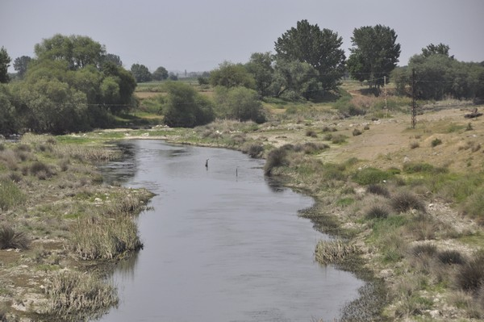
Slaughter at the River (Xanthos to Gods, Scamander to Men)
As they came down to a ford in the blue Xanthos,
Eddying and running, god-begotten
Wondrous river, there Akhilleus drove
Amid the rout and split them, left and right –
Scattering half toward Troy over the plain
Where yesterday Akhaians broke and ran
When Hektor raged. Now Trojans ran that way,
And Hera spread a cloud ahead to slow them.
The other half were forced into the stream
Now running high with foam on whirlpools.
21. 1-10

Slide 7
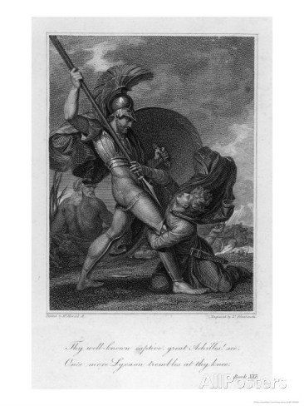
Akhilleus kills Lykaon (son of Priam)
At this the young man’s knees failed, and his heart;
He los his grip upon the spear
And sank down, opening his arms. Akhilleus
Drew his sword, and thrust between his neck
And collarbone, so the two-edged blade went in
Up to the hilt. Now face down on the ground
He lay stretched out, as dark blood flowed from him,
Soaking the earth. Akhilleus picked him up
By one foot, wheeled, and slung him in the river
To be swept off downstream. Then he exulted:
“Nose down there with the fishes….”
21. 132-42

Slide 8
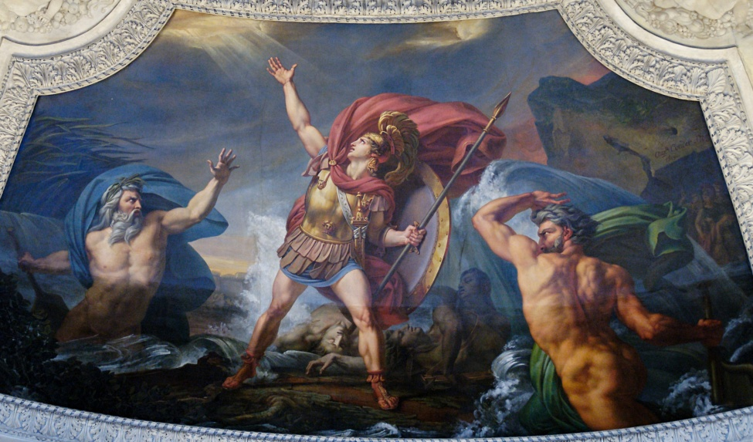
Battle with the River
The great spearman Akhilleus in a flash
Leapt into midstream from the arching bank.
But he, the river, surged upon the man
with all his currents in a roaring flood,
And swept up many of the dead, who jostled
In him, killed by Akhilleus. He ejected
These to landward, bellowing like a bull,
But living men he kept in his blue streams
To hide them in deep places, in backwaters.
21. 273-81

Slide 9
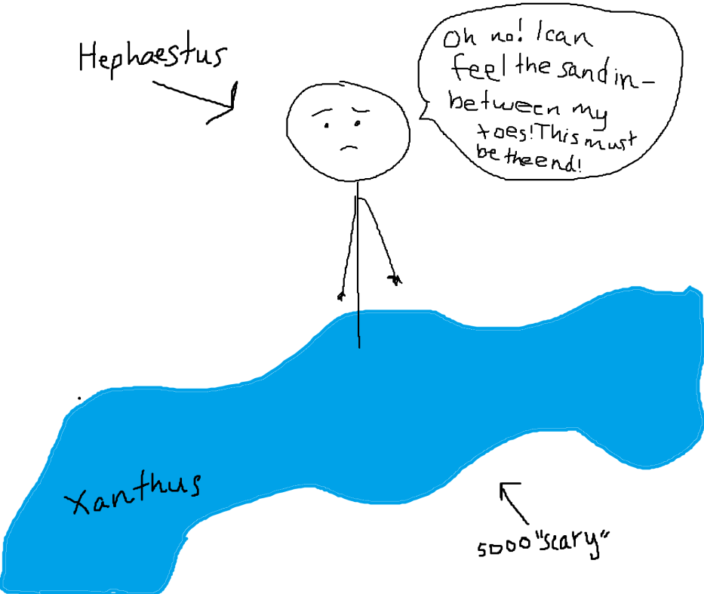
Hephaestus rescues Akhilleus from the river
Hephaistos
Brought heaven’s flame to bear: upon the plain
It broke out first, consuming many dead men
There from the number whom Akhilleus killed,
While all the plain was burned off and the shining
Water stopped. As north wind in late summer
Quickly dries an orchard freshly watered,
To the pleasure of the gardener, just so
The whole reach of the plain grew dry, as fire
Burned the corpses. Then against the river
Hephaestus turned his bright flame, and the elms
And tamarisks and willows burned away,
With all the clover, galingale, and rushes
Plentiful along the winding streams.
Then eels and fish, in backwaters, in currents,
wriggled here and there at the scalding breath
Of torrid blasts from the great smith, Hephaestus…
(21.399-415)

Slide 10
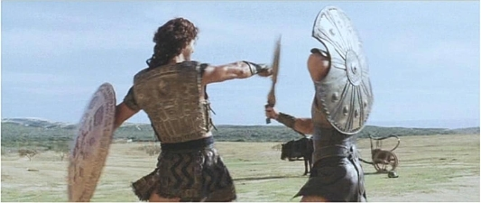
Apollo Tricks Akhilleus
He whisked away Agenor, hid him in mist,
And quietly removed him from the war.
By trickery then he kept the son of Peleus
Away from Trojan soldiers: taking Agenor’s
Likeness to the last detail, he halted
Within range of Akhilleus, who set off
To chase him. For a long time down the plain
Of grainland he pursued him, heading him
Along Skamander, as the god kept a bare lead –
For so Apollo teased him on, Akhilleus
Thought to catch his quarry with a sprint.
Meanwhile the other Trojans in their panic
Reached the walled town, thanking heaven, and all
The city filled up, jammed with men.
21. 692-705

Slide 11
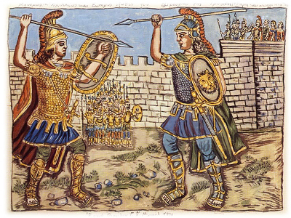
Hektor Stays to Fight
Lord Hektor stood in the gateway, resolute
To fight Akhilleus. Stretching out his hands,
Old Priam said, imploring him: “No, Hektor!
Cut off as you are, alone, dear son,
Don’t try to hold your ground against this man,
Or soon you’ll meet the shock of doom, borne down
By the son of Peleus. He is more powerful
By far than you, and pitiless… (22. 41-48)
Everything done
To a young man killed in war becomes his glory,
Once he is riven by the whetted bronze:
Dead though he be, it is all fair, whatever
Happens then. But when an old man falls,
And dogs disfigure his grey head and cheek
And genitals, that is most harrowing
Of all that men in their hard lives endure.” (22.84-91)

Slide 12
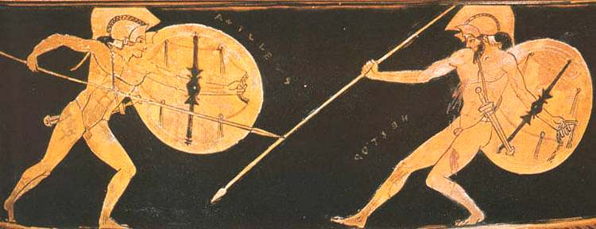
Hektor and Akhilleus Race
Near these fountains are wide washing pools
Of smooth-laid stone, where Trojan wives and daughters
Laundered their smooth linen in the days
Of peace before the Akhaians came. Past these
The two men ran, pursuer and pursued,
And he who fled was noble, he behind
A greater man by far. They ran full speed,
And not for bull’s hide or a ritual beast
or any prize that men compete for: no,
But for the life of Hektor, tamer of horses.
Just as when chariot-teams around a course
Go wheeling swiftly, for the prize is great,
A tripod or a woman, in the games
Held for a dead man, so three times these two
At full speed made their course round Priam’s town,
As all the gods looked on.
22. 183-198

Slide 13
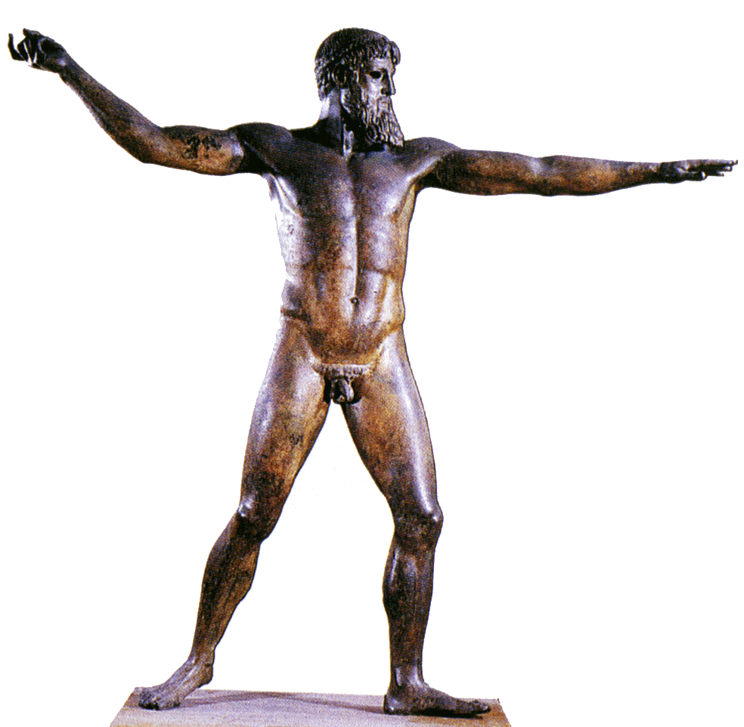
Zeus Laments
“How sad that this beloved man is hunted
Around the wall before my eyes! My heart
Is touched for Hektor; he has burned thigh flesh
Of oxen for me often, high on Ida,
At other times on the high point of Troy…
Come, gods, put your minds on it, consider
Whether we may deliver him from death
Or see him, noble as he is, brought down
By Peleus’ son, Akhilleus.”
22. 200-210

Slide 14
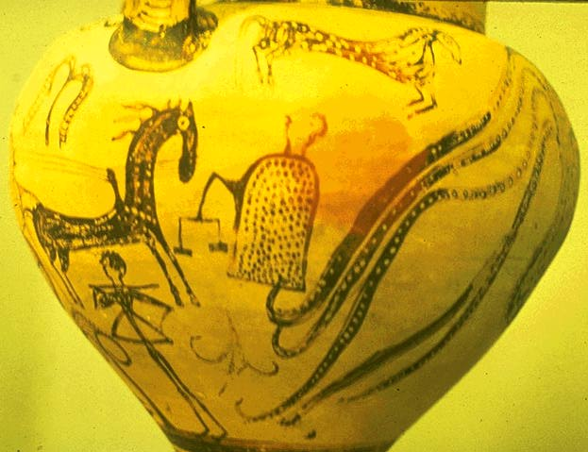
Hector Runs
As in a dream a man chasing another
Cannot catch him, nor can he in flight
Escape from his pursuer, so Akhilleus
Could not by swiftness overtake him
Nor could Hektor pull away….
But when, for the fourth time, they reached the springs,
The father poised the golden scales. He placed
two shapes of death, death prone and cold, upon them,
One of Akhilleus, one of the horseman, Hektor,
And held the midpoint, pulling upward. Down
Sank Hektor’s fatal day, the pan went down
Toward undergloom, and Phoibos Apollo left him.
22. 235-52

Slide 15
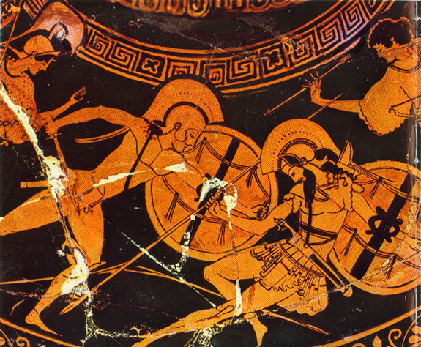
Athena’s Trick; the Death of Hektor
She left him there
And overtook Lord Hektor – but she seemed
Deiphobos in form and resonant voice,
Appearing at his shoulder, saying swiftly:
“Ai! Dear brother, how he runs, Akhilleus,
Harrying you around the town of Priam!
Come, we’ll stand and take him on.”
22.269-75
“I see you now for who you are. No chances
To win you over. Iron in your breast
Your heart is. Think a bit, though: this may be
A thing the gods in anger hold against you
On that day when Paris and Apollo
Destroy you at the gates, great as you are.”
22. 424-429

Slide 16
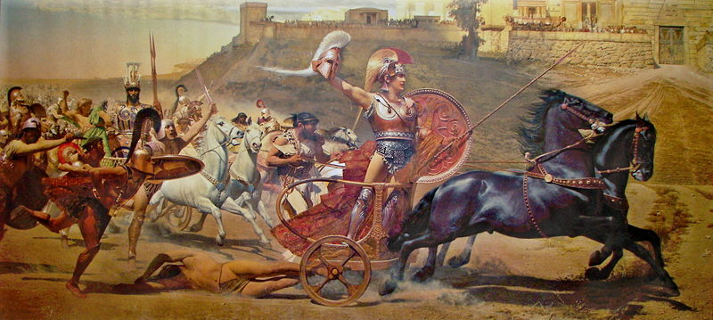
Akhilleus and Hektor’s Body
Indeed, he had in mind for Hektor’s body
Outrage and shame. Behind both feet he pierced
The tendons, heel to ankle. Rawhide cords
He drew through both and lashed them to his chariot,
Letting the man’s head trail. Stepping aboard,
Bearing the great trophy of the arms,
He shook the reins, and whipped the team ahead
Into a willing run. A dustcloud rose
Above the furrowing body; the dark tresses
Flowed behind, and the head so princely once
Lay back in dust. 22.467-477

Slide 17
Quiz Question
4. What does Akhilleus do to honor Patroklos?
Gives him an elaborate funeral.
Conducts a human sacrifice in his honor.
Holds funeral games in his honor.
All of the above.

Slide 18
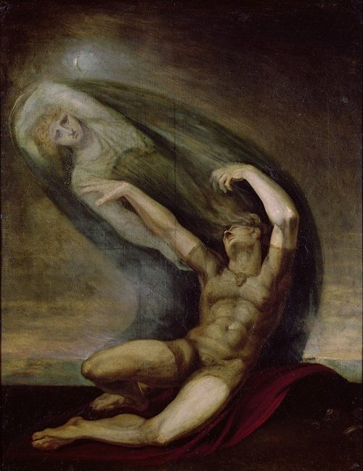
Akhilleus Dreams of Patroklos
Sleeping so? Thou hast forgotten me,
Akhilleus. Never was I uncared for
In life but am in death. Accord me burial
In all haste, let me pass the gates of Death.
Shades that are images of used-up men
Motion me away, will not receive me
Among their hosts beyond the river.
23. 80-86

Slide 19
Patroklos’ Funeral
Cremation
Cutting of lock of hair
Libations poured onto pyre
Rams sacrificed
Dogs sacrificed
Human sacrifice (12 Trojan captives)
All-night vigil
Meanwhile Akhilleus wants Hektor’s corpse to rot, but the gods prevent this

Slide 20
Funeral Games for Patroklos
Agon: competition, agony
held in honor of dead heroes
Basis for Olympic Games, other Panhellenic Games
Normally the dead hero awards the prizes
Here, Achilles (soon to die) gives them out himself

Slide 21
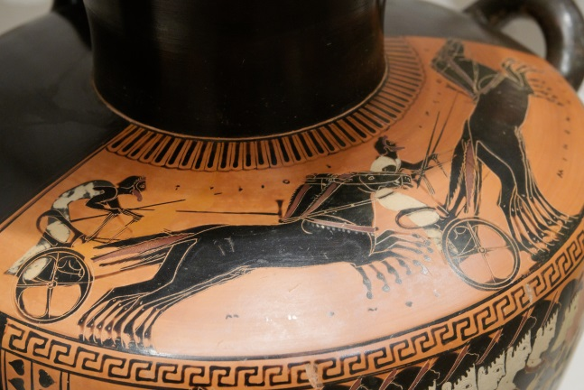
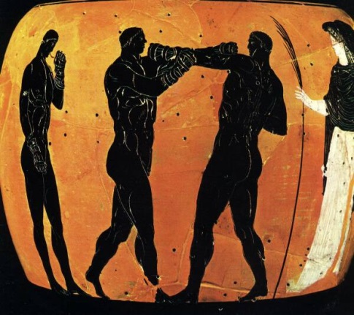
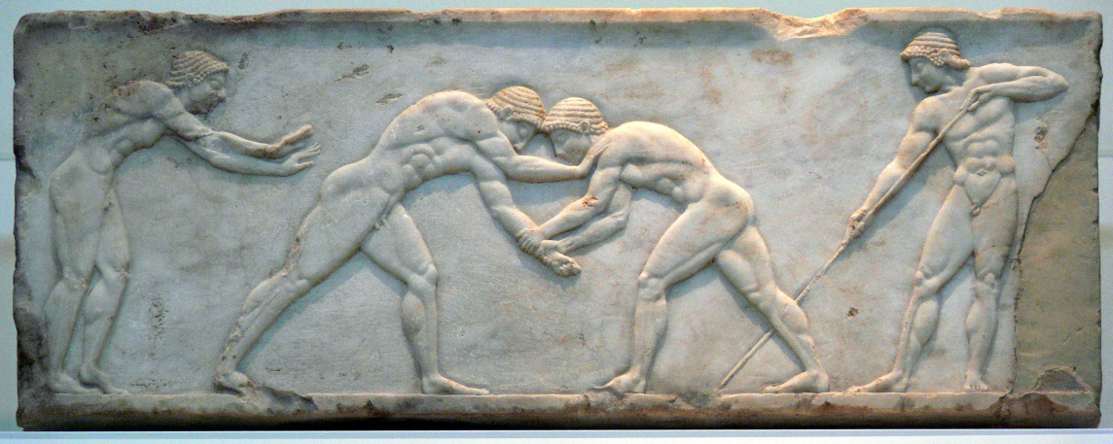
Funeral Games for Patroklos
Competitions:
Chariot racing
Boxing
Wrestling
Footrace
Footrace in armor
Shot put
Archery
(Javelin)

Slide 22
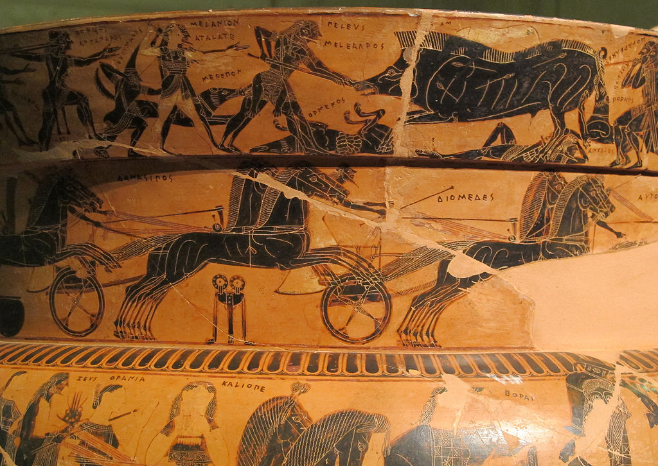
Funeral Games for Patroklos
Actual results of Chariot Race:
Diomedes
Antilokhos (son of Nestor)
Menelaus
Meriones
Eumelos
Prizes as Awarded
Diomedes
Menelaus, since Antilokhos cheated, but gives prize to Antilokhos
Antilokhos, given to Menelaus
Meriones
Nestor (!)
Eumelos’ special honorary-second prize

Slide 23
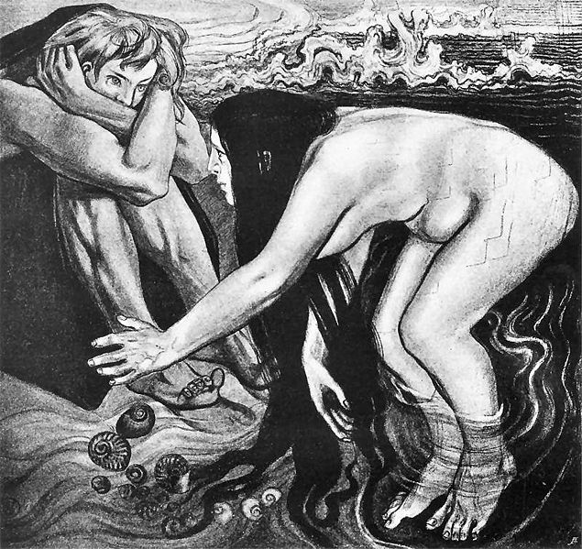
Thetis and Akhilleus
My child,
Will you forever feed on your own heart
in grief and pain, and take no thought of sleep
Or sustenance? It would be comforting
To make love with a woman. No long time
Will you live on for me: Death even now
Stands near you, appointed and all-powerful.
But be alert and listen: I am a messenger
From Zeus, who tells me the gods are sullen toward you
And he himself most angered at your madness,
Holding the body by the beaked ships
And not releasing it. Give Hektor back,
Take ransom for the body.”
24. 152-64

Slide 24
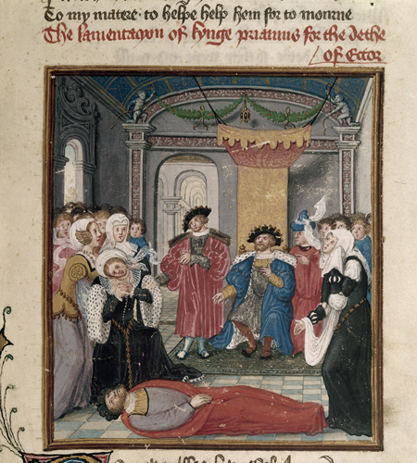
Priam Mourns for Hektor
In the court
She found the princes huddled around their father,
Faces and clothing wet with tears. The old man,
Fiercely wrapped and hooded in his mantle,
Sat like a figure graven – caked in filth
His hands had swept over head and neck
When he lay rolling on the ground. Indoors
His daughters and his sons’ wives were weeping,
Remembering how many and how brave
The young men were who had gone down to death
Before the Argive spearmen.
24. 192-203

Slide 25
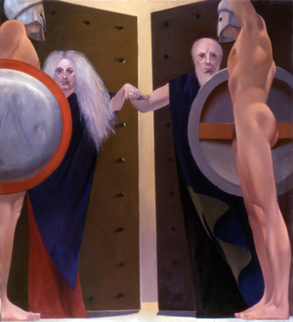
Priam’s Journey
In majesty old Priam said: “My heart
Is fixed on going. Do not hold me back,
And do not make yourself a raven crying
Calamity at home. You will not move me.
If any man on earth had urged this on me –
Reader of altar smoke, prophet or priest –
We’d say it was a lie, and hold aloof.
But no: with my own ears I heard the voice,
I saw the god before me. Go I shall,
And no more words. If I must die alongside
The ships of the Akhaians in their bronze,
I die gladly. May I but hold my son,
And spend my grief; then let Akhilleus kill me.”
24. 261-273
.

Slide 26
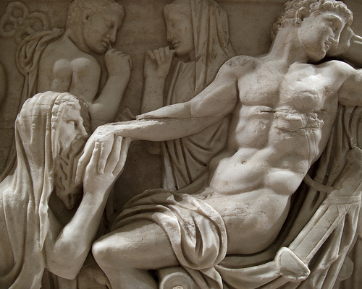
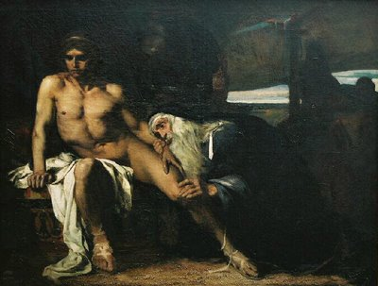
Priam and Akhilleus Speak
Priam, the great king of troy, passed by the others,
Knelt down, took in his arms Akhilleus’ knees,
And kissed the hands of wrath that killed his sons.
…
“Akhilleus, be reverent toward the great gods! And take
Pity on me, remember your own father.
Think me more pitiful by far, since I
Have brought myself to do what no man else
Has done before – to lift to my lips the hand
Of one who killed my son.” Now in Akhilleus
The evocation of his father stirred
New longing, and an ache of grief. He lifted
The old man’s hand, and gently put him by.
Then both were overborne as they remembered:
The old king huddled at Akhilleus’ feet
Wept, and wept for Hektor, killer of men,
While great Akhilleus wept for his own father
As for Patroklos once again; and sobbing filled the room.
24. 570-72; 603-617

Slide 27
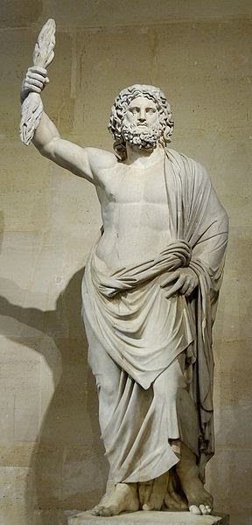
Achilles’ Wisdom
Tears heal nothing,
Drying so stiff and cold. This is the way
The gods ordained the destiny of men,
To bear such burdens in our lives, while they
Feel no affliction. At the door of Zeus
Are those two urns of good and evil gifts
That he may choose for us; and one for whom
The lightning’s joyous king dips in both urns
Will have by turns bad luck and good. But one
To whom he sends all evil – that man goes
Contemptible by the will of Zeus; ravenous
Hunger drives him over the wondrous earth,
Unresting, without honor from gods or men.
24. 630-43

Slide 28
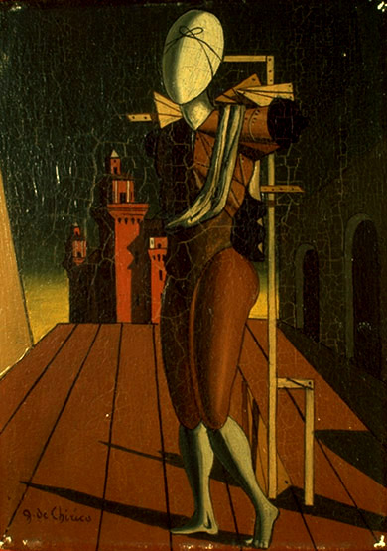
The Funeral of Hektor
Andromache: “You’ve been torn from life,
My husband, in young manhood, and you leave me
Empty in our hall. The boy’s a child
Whom you and I, poor souls, conceived; I doubt
He’ll come to manhood. Long before, great Troy
Will go down plundered, citadel and all,
Now that you are lost, who guarded it
And kept it, and preserved its wives and children.
They will be shipped off in the murmuring hulls
One day, and I along with all the rest….
24.867-876
Hekabe, Helen also mourn Hektor

Slide 29
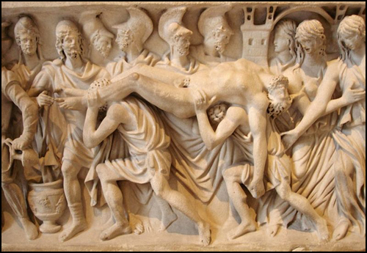
The End.
So they performed the funeral rites of Hektor, tamer of horses.

Slide 30
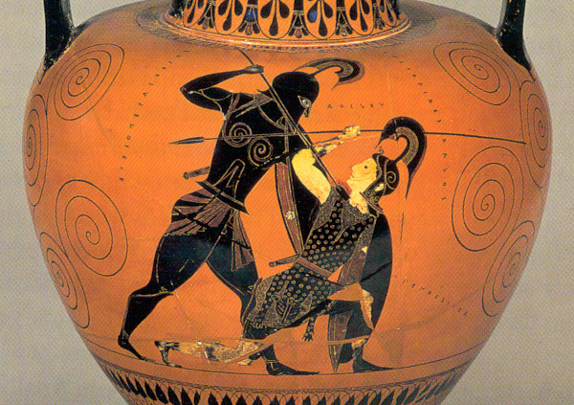
Or is it?....
So they performed the funeral rites of Hektor. Then an Amazon came…

Slide 31
Quiz Question
5. Which of the following does not perform a lament at the funeral of Hektor?
Andromakhe
Hekabe
Briseis
Helen

